Slide 1
Financial Fraud Detection

Slide 2
CASE
Fraud Detection in Financial Reporting

Slide 3
Introduction
Cases of Enron, WorldCom, HealthSouth, etc. is well known
The fraud detection was after years of abuse by senior management;
The Securities and Exchange Commission (SEC) did not detect it proactively.

Slide 4
Definition of Fraud
SEC issues an Accounting and Auditing Enforcement Release (AAER)
This is the starting point for defining
It entails an accounting or auditing related violation of the securities
Fraud is defined when SEC used the word fraud in describing the violation in AAER

Slide 5
Problem Statement
Fraud detection is after the fact and officially recognized only after the SEC issues an AAER.
A high level of senior management compensation comes from stock options. This leads to the conclusion that corporate fraud is likely to continue at the senior executive level
The “New Economy” makes fraud a normal circumstance because of the requirement to predict and deliver continually increasing earnings by the corporate

Slide 6
Objectives
Can the fraud be detected from the text of annual corporate SEC filings?
Can a quantitative and computational-based fraud detection model be developed that will provide a methodology for automating detection of potential fraud?

Slide 7
Text Mining
The relationships between words in documents form patterns.
Detection of these patterns is the primary focus of text mining
TM is a quantitative methodology that uses mathematical methods to describe the term-document matrix and increases the density through use of a singular value decomposition vector (SVD)

Slide 8
Process for Analysis - 1
Select the target companies and target document.
Extract the target text from the document.
Prepare the target text for importing into the miner.
Import all of the target text documents into the miner creating a database

Slide 9
Process for Analysis - 2
Stem terms to reduce the dimensions and to tag parts of speech.
Create SVDs to further reduce the document dimensions.
Cluster the document set.
Review and evaluate the clustering results.
Modify the SVD and clustering algorithm as necessary.

Slide 10
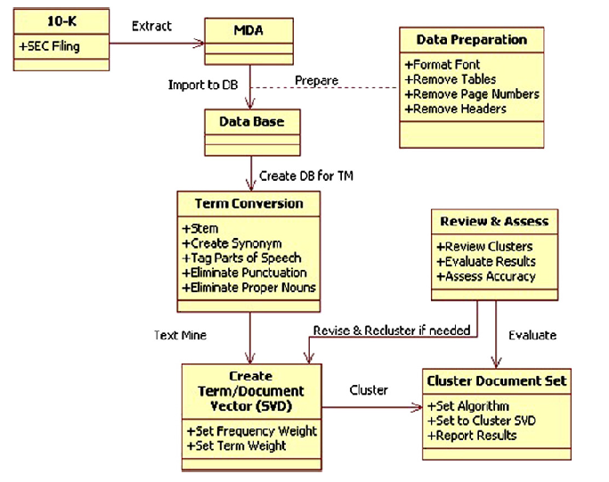

Slide 11
Sample Selection
Companies where SEC issued an AAER citing fraud were selected
Each of these was matched with a company in the same SIC code and of approximately the same size that had not been charged with fraud
The primary screening was for companies that had not been cited in the last ten years.

Slide 12
Methodology
The target was at least one year prior to the latest period cited in the AAER
SEC investigation often takes an extended period, there were several cases where went back more than one year.
The matching company was from the same time period.

Slide 13
Target Text
Management's Discussion and Analysis
Senior management assists in the preparation of the MDA and may even write MDA
If fraud exists and the writer knows that it exists and has an incentive to deceive the reader
The MDA should provide clues of deception or fraud

Slide 14
The target document is the10-K.
A 10-K is a comprehensive report filed annually by a publicly traded company about its financial performance and is required by the U.S. Securities and Exchange Commission (SEC). The report contains much more detail than a company's annual report
The preferred 10-K for testing the model was at least one year prior to the latest period cited in the AAER.
If the AAER complaint accused the company of committing fraud for period from 2002 to 2005, the 10-K for 2004 was selected for the analysis.

Slide 15
If the selected 10-K mentions that the SEC is investigating the company, then the 10-K for the prior year was selected.
Because the SEC investigation often takes an extended period, there were several cases where we had to go back more than one year.
The matching company 10-K was from the same time period, to reduce any potential bias caused by changing accounting rules, legal requirements, or other external influences.
There are two major blocks of text in a 10-K, the MDA and the Notes to the Financial Statement

Slide 16
Text Preparation
Synonyms to create equal meaning words,
Identify parts of speech to create separate words,
Eliminate punctuation, and stop words
The words or terms were stemmed retaining POS
Log frequency weighting and information gain term weighting were used for SVD (Single Value Decomposition vector).

Slide 17
Analysis
Clustering was performed on SVDs
The documents clustered into two stable clusters.
The documents were separated those with Fraud and without
No false negatives and three false positives in sixty-nine documents

Slide 18
Important Terms
Eight highest weighted terms representing clusters.
Cluster 1 : No AAER | Affect, require, expense, rate, do, cost, year, and determine
Cluster 2 : AAER | Represent, account, relate, continue, reduce, reflect, sell, and expect

Slide 19
Test Dataset
The Model was tested on a new sample of ten MDAs that received AAERs accusing them of fraud.
Of the ten fraudulent MDAs, the Model clustered nine to be fraudulent.
This MDA was from the first year the SEC cited in the AAER, and the SEC said that the fraud started mid-year.
The MDA from the following year was tested using the CFDM, and it clustered as fraudulent

Slide 20
Test Dataset
Sample Data | Correctly identified | Incorrectly Identified
Fraudulent MDAs | 90.91% | 9.09%
Non-Fraudulent MDAs | 80.00% | 20.00%

Slide 21
Questions?
Fletcher H. Glancy and Surya B. Yadav, A computational model for financial reporting fraud detection, Decision Support Systems 50 (2011) 595–601

